Slide 1
M1-International track
Escape game
Scenario: Find the code to open the briefcase containing the virus cure
Introductory video “home made”
Virtual DNA sequence with an ink stain
Restriction digest analysis DNA gel
Picture: onion root tip cells in various stages of the cell cycle.
Guessing card on Meselson and Stahl experiment
QR code help card
Card with a coded message
DNA base paring schema: A=T
Message written in police 2
Coded message to references
Reference documents/book
QR code help cards
HP reveal
% of light DNA propositions
Alphabet decoder wheel
Binocular
loop
Introductory video
TGGCCAGTAGATATC
TAC
CT
GGGGGG
AA
TTTTTT
DNA coding strand
Color coded DNA sequence: 5’-TGGCCAGTAGATATCTACCTGGGGGGAATTTTTT-3’
Corresponding RNA sequence : 5’-ACCGGUCAUCUAUAGAUGGACCCCCCUUAAAAAA-3’
Genetic code
Corresponding peptide : NH3⁺-TGHL.MDPP.K-C00⁻ keep the one with an initiation codon: MDPPO (0=Stop)
Cryptex opening code
padlock key
UV visible enigma
New peptide: MDPPQ
Protozoa gallery with alternative genetic code
UV lamp locked in a jar
END point
Briefcase opening code

Slide 2
DNA template

Slide 3
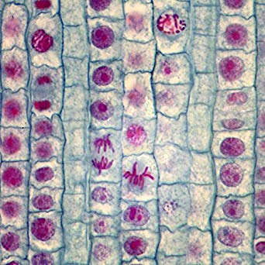
The enigma is embedded in a cell in metaphase

Slide 4
TAC

Slide 5
52 - 34 - 4
354 - 55 - 4
390 - 18 - 1
186 - 44 - 4

Slide 6
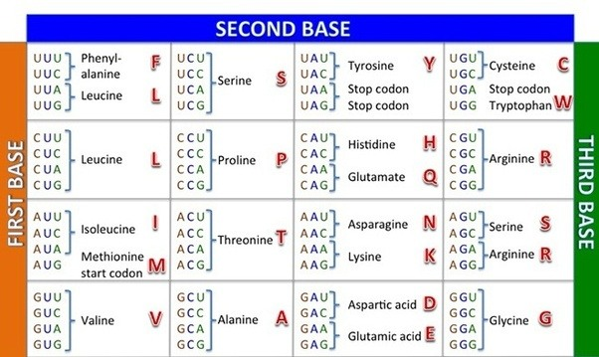
O
O

